Slide 1
Mean Shift Algorithm
Presented By:
Eldridge Fernandes
Rakkshab Iyer
Ashvinjeet Singh
Instructor: Dr. Yaseer Alginahi
Date: November 3rd, 2023

Slide 2
Table of Contents
Clustering – Types and Challenges
Mean-Shift Algorithm
Gradient Ascent
How does Mean-Shift algorithm work
Pros and Cons of the algorithm
Comparison with other clustering algorithms
Applications
Summary

Slide 3
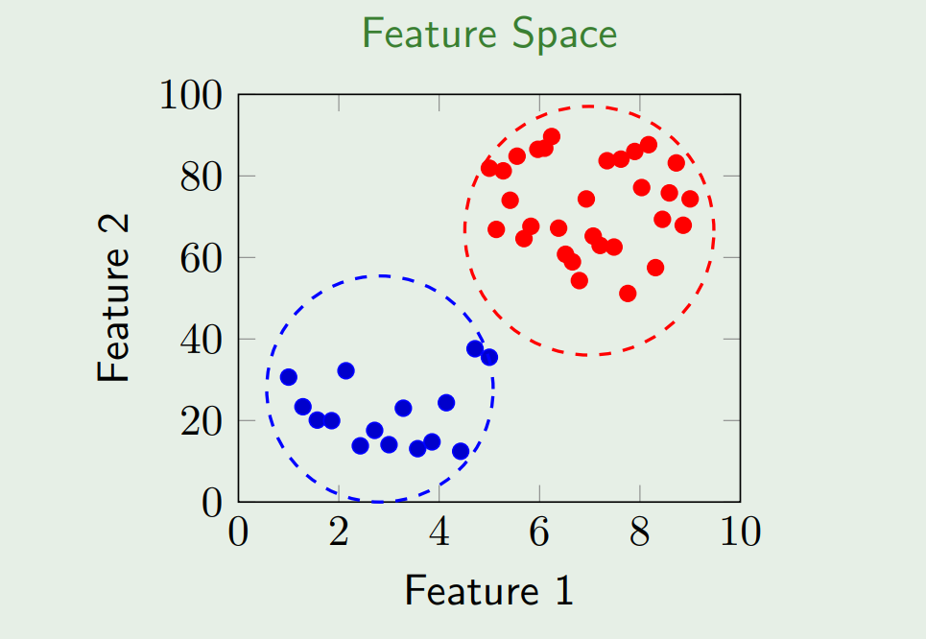
What is Clustering?
Clustering is the process of finding a pattern in a collection of unlabeled data based on the similarity feature.
It reduces a set of infinite values into finite values
Similarity Feature measures similarity between examples and compresses them into a relevant cluster with its respective cluster ID
It helps deals with challenges like outliers, missing data, and categorical versus numerical data
Cluster formation of similar features
Image Source: Taken from [1]

Slide 4
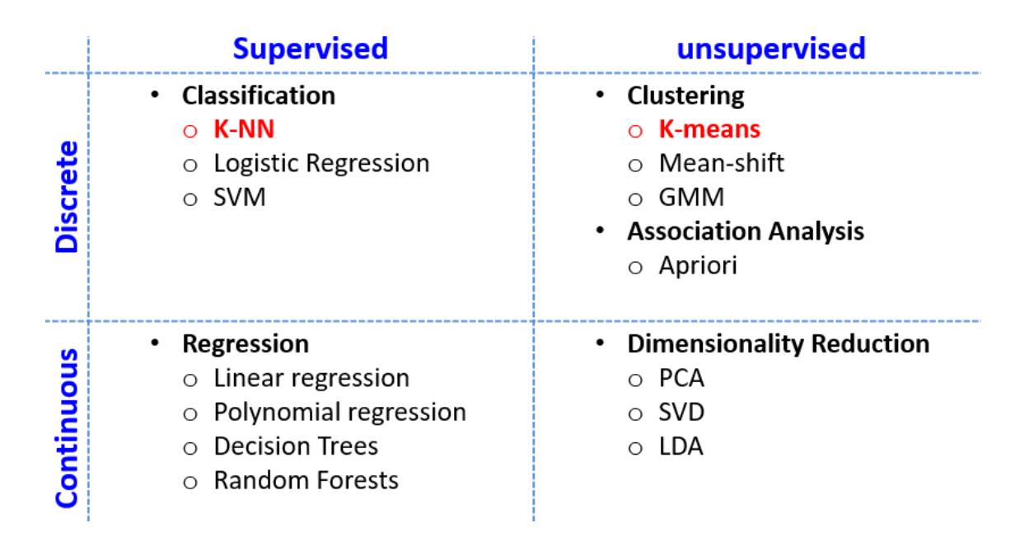
Types of Clustering
Image Source: Taken from [1]

Slide 5
Challenges in Clustering
Algorithm should scale to your dataset
Number of clusters may be unknown
Datasets have millions of records and clustering algorithms will not be able to scale it efficiently as the runtime increases as the square of the number of examples ,i.e., O(n²)

Slide 6
Mean-Shift Algorithm
It is a non-parametric feature-space mathematical analysis technique
Mean Shift algorithm calculates maxima and minima of a density function
Assigns data-points to the clusters iteratively by shifting points towards the mode (highest density data points)
The kernel is shifted iteratively to a higher density region until convergence and the shift is defined by a mean shift vector

Slide 7
Gradient Ascent
Gradient ascent is based on the principle of locating the greatest point on a function and then moving in the direction of the gradient
In simpler terms, moving uphill, from a region of lower density to a higher density point
Image Source: Taken from [1]

Slide 8
Basic Idea
A flexible approach to density estimation (“how many data points are in a certain region?”)
Find the local modes of this density
All points that “belong” or “lead” to the same mode form a cluster

Slide 9
How Does the Mean-Shift Algorithm Work?

Slide 10
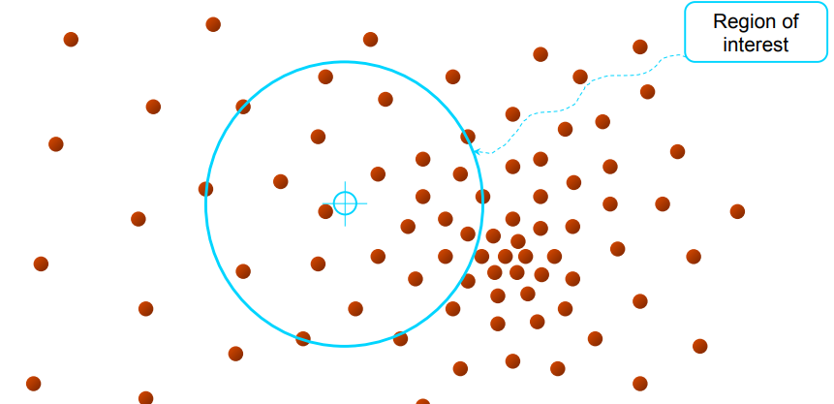
Initialization of a Window
Initialize a random seed (choose any data point)
With the coordinates of this point as the centroid, consider an imaginary window (size=d)
Window size should be optimal; not too large, not too small
Image Courtesy: https://shorturl.at/exGT2

Slide 11
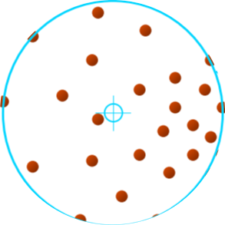
Mean-Calculation Phase
Calculate the mean coordinates considering all of the data points lying inside the window
This can be a simple mean or weighted mean
Image Courtesy: https://shorturl.at/exGT2

Slide 12
Weighted Mean Calculation
Weighted mean is the mean calculated by assigning weights to the neighboring data based on their distance from the sample point.
Neighbors near the point will have a larger weight as compared to the ones farther away.
Usually weighted mean is preferred since it reduces the impact of the data points farther away from the sample point.

Slide 13
Kernel Density Estimation
Kernel Density Estimation can be defined as a technique that estimates a real valued function as the weighted average of neighboring observed data.
The weights (kernels) assigned to the features are calculated based on this method.

Slide 14
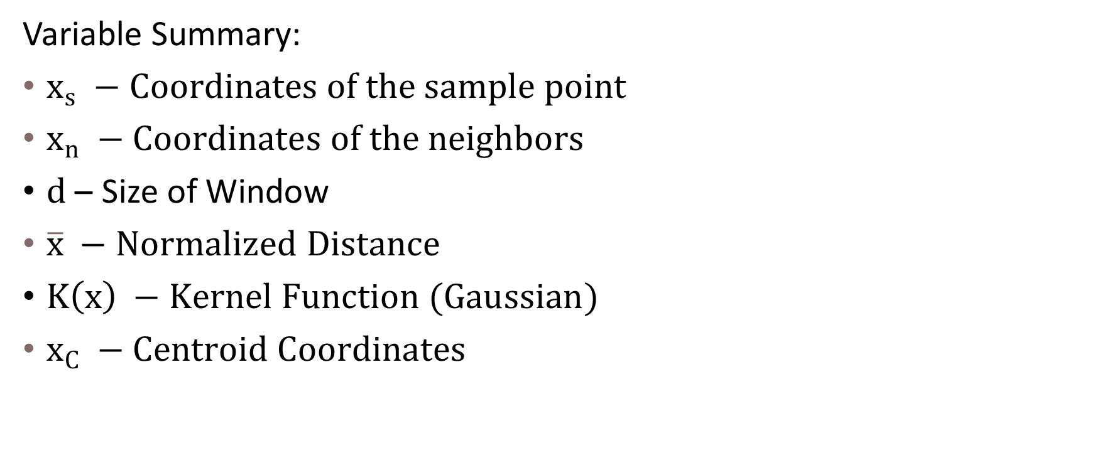
Weight/Kernel Calculation
Variable Summary:
$x_{s} −Coordinates of the sample point$
$x_{n} −Coordinates of the neighbors$
$d$ – Size of Window
$\overline{x} −Normalized Distance$
$K\left(x\right) −Kernel Function (Gaussian)$
$x_{C} −Centroid Coordinates$
12

Slide 15
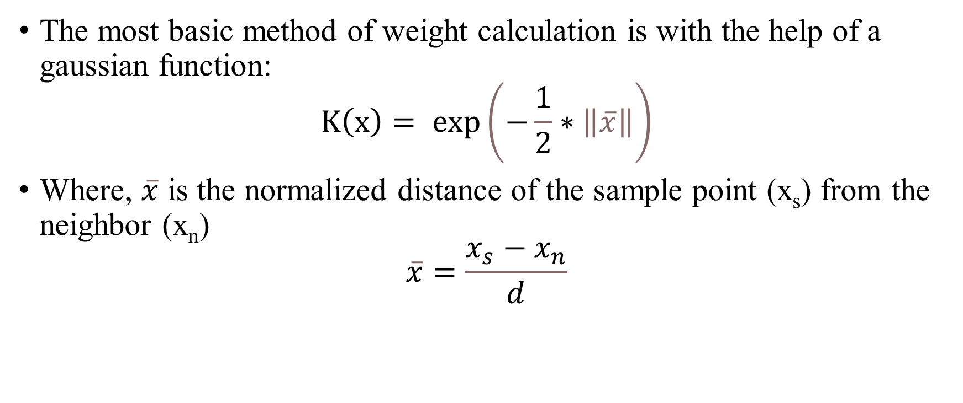
Weight/Kernel Calculation (cont.)
The most basic method of weight calculation is with the help of a gaussian function:
$$K\left(x\right)= exp\left(−\frac{1}{2}∗\left\|\overline{x}\right\|\right)$$
Where, $\overline{x}$ is the normalized distance of the sample point (x_{s}) from the neighbor (x_{n})
$$\overline{x}=\frac{x_{s}−x_{n}}{d}$$

Slide 16
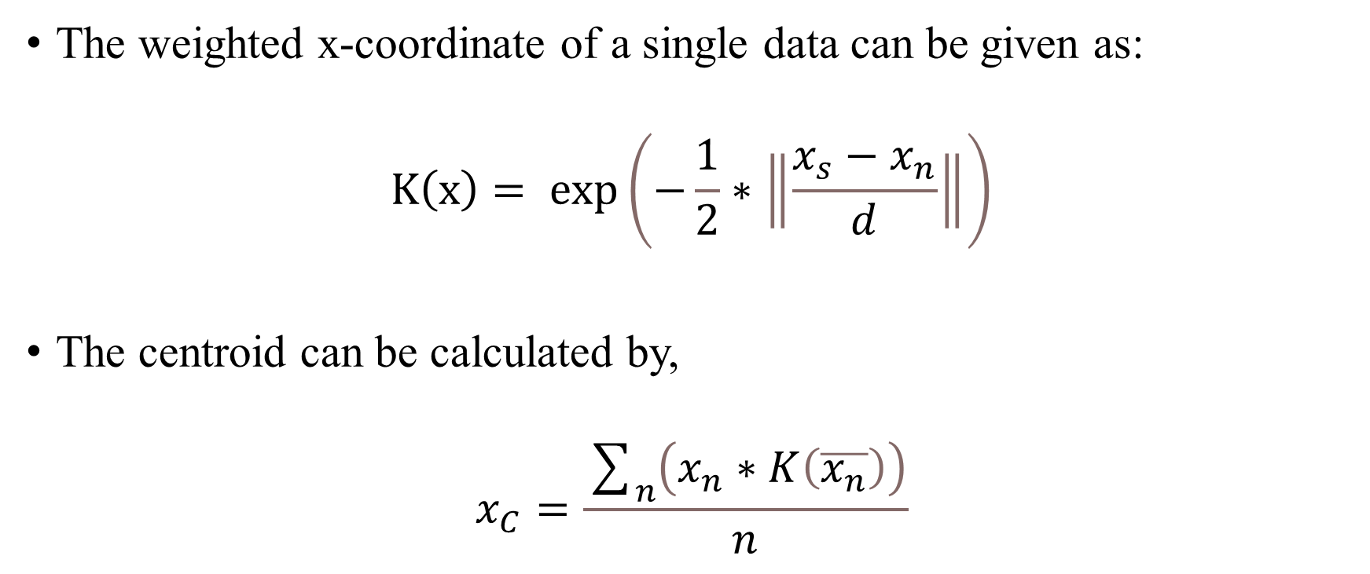
Centroid Calculation
The weighted x-coordinate of a single data can be given as:
$$K\left(x\right)= exp\left(−\frac{1}{2}∗\left\|\frac{x_{s}−x_{n}}{d}\right\|\right)$$
The centroid can be calculated by,
$$x_{C}=\frac{\sum_{n}{\left(x_{n}∗K\left(\overline{x_{n}}\right)\right)}}{n}$$

Slide 17
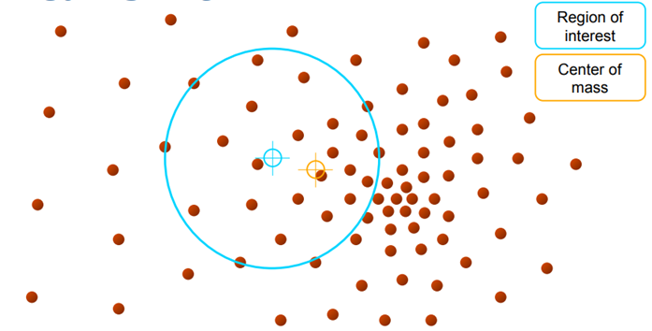
Centroid Calculation (cont.)
Similar procedure is followed to calculate the centroids for all other coordinates
Higher dimensional data would require much more complex calculation and suitable hardware for execution
Image Courtesy: https://shorturl.at/exGT2

Slide 18
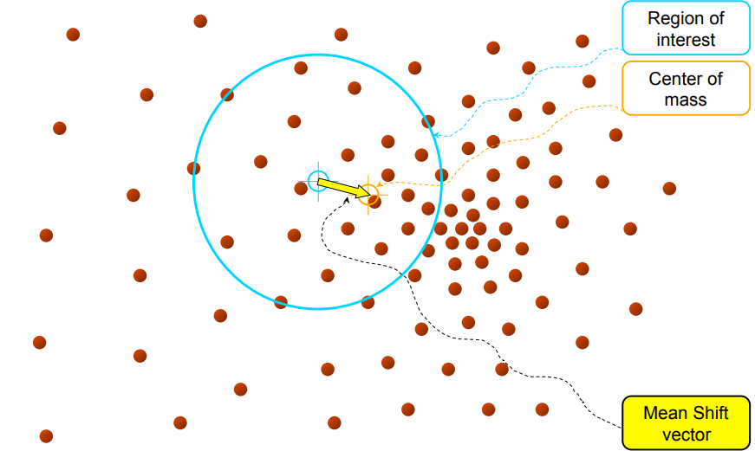
Shifting the Window
The window is shifted to these centroid coordinates so as to make these coordinates the new center
“Mean-Shift Vector” signifies the window shift
It is a unit vector, representing the direction of shift
Image Courtesy: https://shorturl.at/exGT2

Slide 19
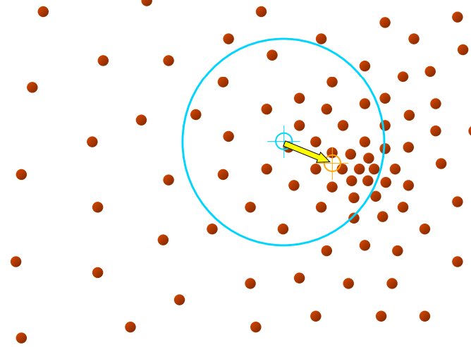
Shifting the Window (cont.)
Again, the new centroid for the shifted window is calculated
The window is shifted toward this centroid
This process repeats until convergence
Image Courtesy: https://shorturl.at/exGT2

Slide 20
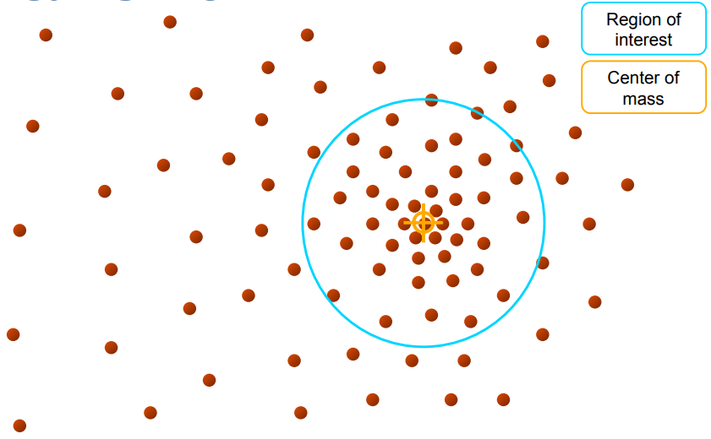
When to Stop?
At some point, the window's centroid stops changing or more accurately, the changes are insignificant
It can be said that, the window has reached a point with high data density (local maxima) and this point can be treated as a cluster label
This is known as convergence and signifies end of the loop
Image Courtesy: https://shorturl.at/exGT2

Slide 21
Algorithm Summary
Choose kernel function and window size
For each point:
Center a window on that point
Compute the mean of the data in the search window
Center the search window at the new mean location
Repeat (b,c) until convergence
Assign points that lead to nearby modes to the same cluster
Image Courtesy: https://shorturl.at/aditM

Slide 22
Pros and Cons
Pro’s | Con’s
No model assumption is made like K-means | Doesn’t perform well in high dimensional cases
Application-independent tool and its model doesn’t assume prior shape | Computational expensive and no control on specific number of clusters
The number of clusters is determined by the algorithm with respect to the data | Cannot differentiate between meaningful and meaningless modes
Local minima issues like K-means are averted | Inapproriate window size can cause modes to be merged or shallow modes
Robust to Outlier problems | Often requires adaptive window size

Slide 23
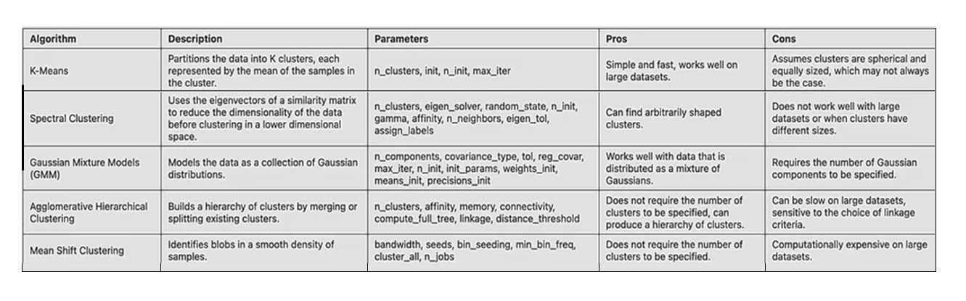
Comparison with Other Clustering Methods
Image Source: https://shorturl.at/ekGPQ
21

Slide 24
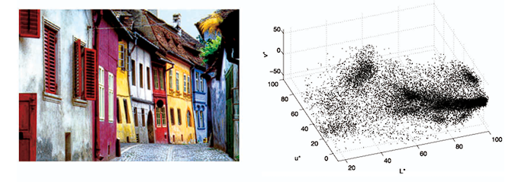
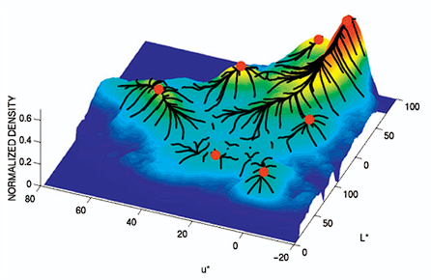
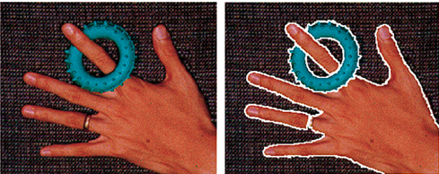
Applications of Mean-Shift Algorithm
Video Object Tracking
Anomaly detection
Image segmentation
Image denoising
Spatial Data Analysis
Document categorization and topic modelling
Remote sensing
Image Source: https://shorturl.at/ekGPQ

Slide 25
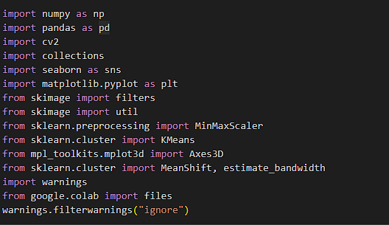
Implementation of Mean shift Algorithm
Implementation of a machine learning model to precisely segment features and objects in high-resolution aerial photos taken by unmanned aerial vehicles (UAVs) in order to facilitate environmental monitoring, object detection, and precise land analysis Code reference:-https://tinyurl.com/Google-collab Article reference:-Medium
Here we have imported all the libraries required for the implementation

Slide 26
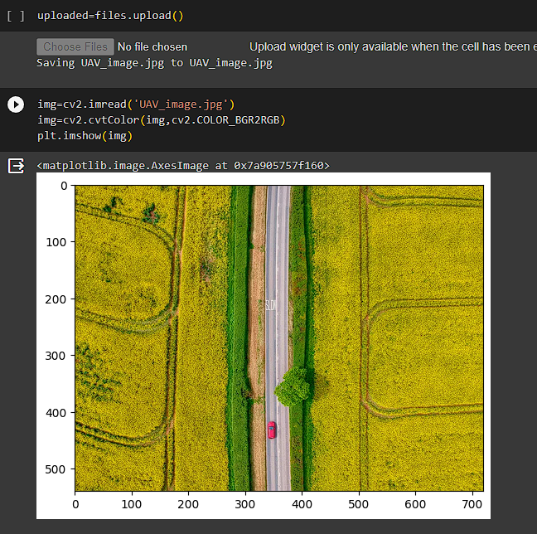
Imported a local image to collab notebook of a drone shot a field

Slide 27
Mean shift builds on kernel density estimation. Kernel density estimation estimate PDF(probability density function) for a set of data. t works by placing a kernel on each point in the data set. A kernel has a mathematical algorithm for weighting function generally user in convolution. There are many different kernels. But the most popular one is the Gaussian kernel.
Here are we calculating the best bandwidth which is specified by feature selection
Here the bandwidths are calculated as 3 and 5, respectively. calculated that 0.13559591178830535 and 0.034407035660636826.
Next step is clustering, cluster_all parameter can be set False. That means that if the dataset have noise depends on clusters, these point never passing values. That properties is quite useful if you want to eliminate anomaly of the image.
Bin seeding helps to speed up the algorithm on a backend
25

Slide 28
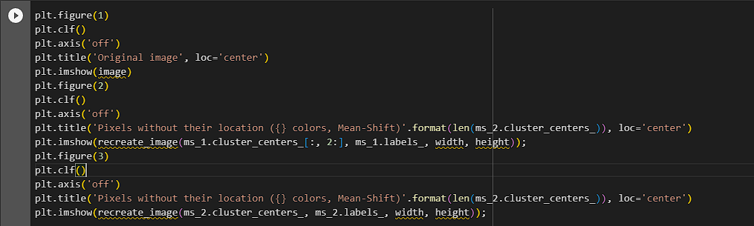
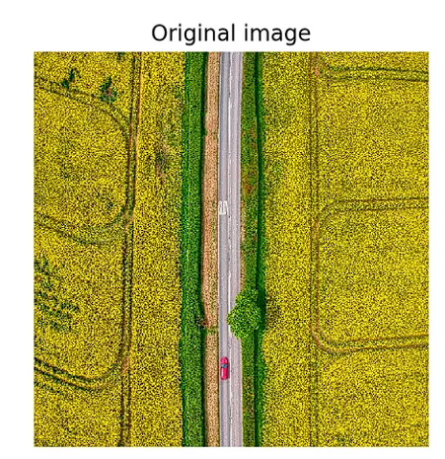
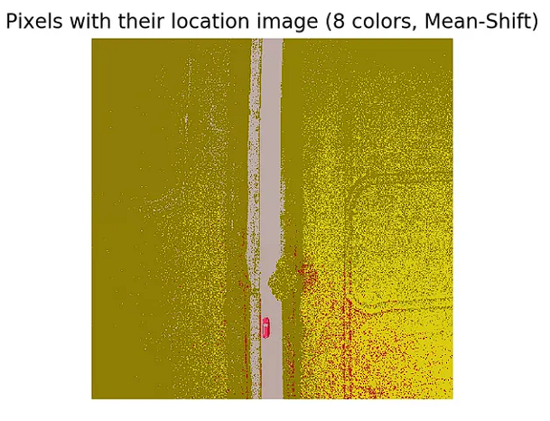
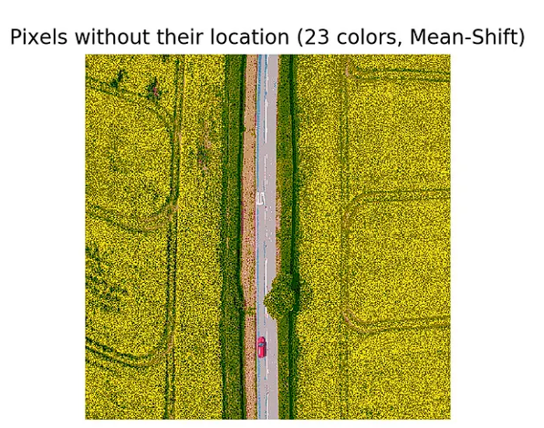
Here the final code to plot all the images with different bandwidths
26

Slide 29
References
[1] Robust Analysis of Feature Space: Color Image Segmentation,” by D. Comaniciu and P.Meer, CVPR 1997, pp. 750-755.
[2] https://developers.google.com/machine-learning/clustering/overview
[3] https://prutor.ai/clustering-algorithms-mean-shift-algorithm/
[4] https://medium.com/@sina.nazeri/comparing-the-state-of-the-art-clustering-algorithms-1e65a08157a1
[5] https://medium.com/@sina.nazeri/comparing-the-state-of-the-art-clustering-algorithms-1e65a08157a1
[6] https://www.preprints.org/manuscript/202108.0140/v1
[7] https://www.freecodecamp.org/news/8-clustering-algorithms-in-machine-learning-that-all-data-scientists-should-know/
[8] https://github.com/EmirKorkutUnal/A-Comparison-of-Clustering-Algorithms-K-means-MeanShift-DBSCAN-in-Python

